Slide 1
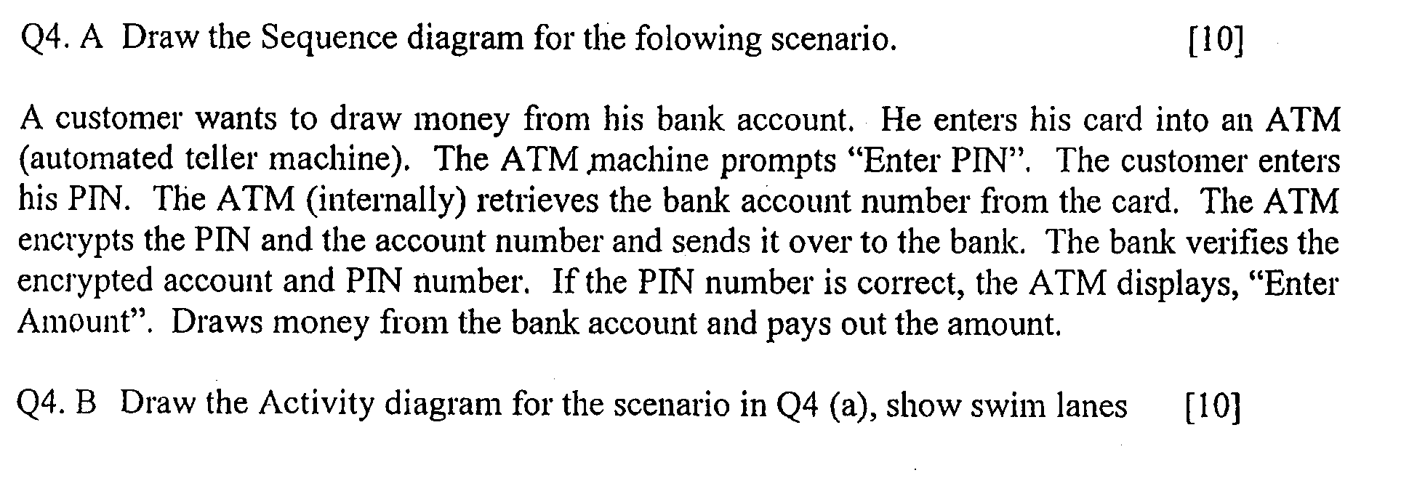
Sequence Diagram

Slide 2
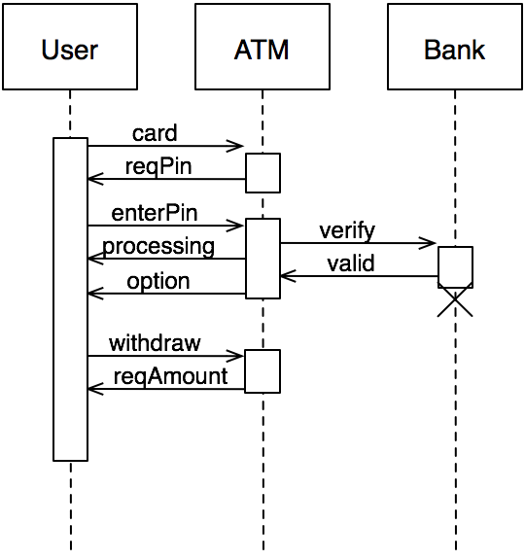
Sequence Diagram

Slide 3
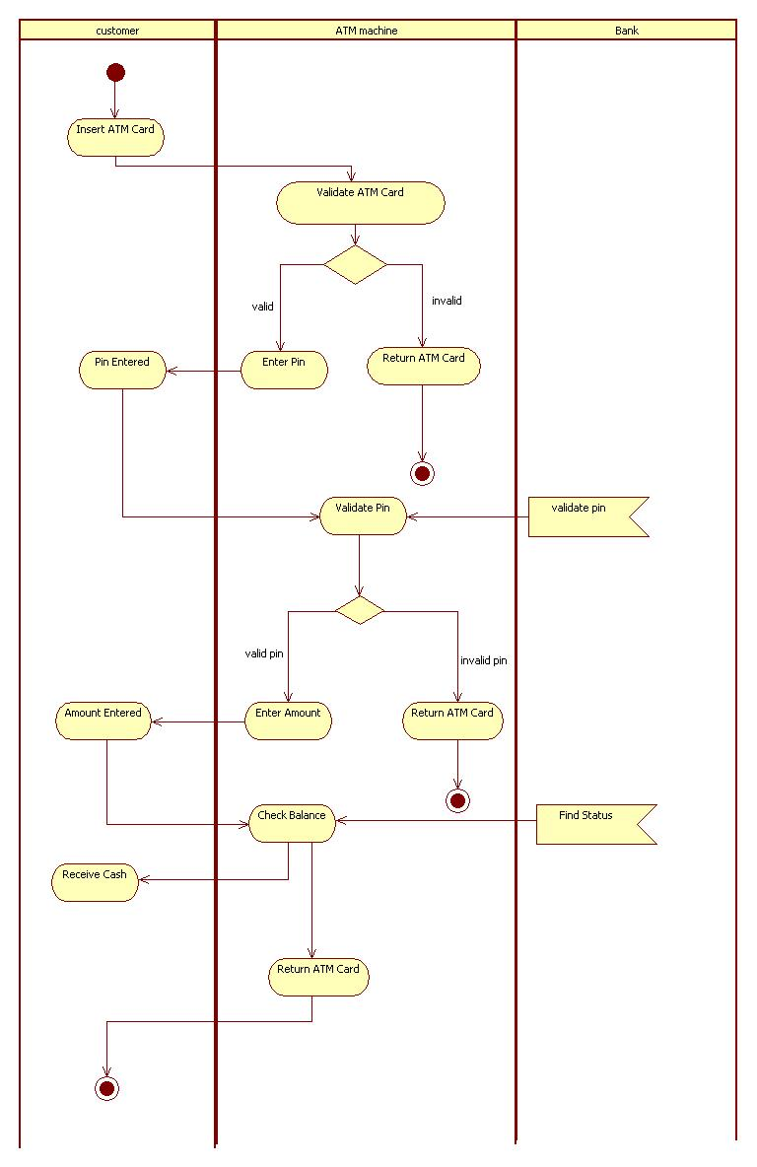
Activity Daigram

Slide 4
Activity Diagram
Describes how activities are coordinated.
Is particularly useful when you know that an operation has to achieve a number of different things, and you want to model what the essential dependencies between them are, before you decide in what order to do them.
Records the dependencies between activities, such as which things can happen in parallel and what must be finished before something else can start.
Represents the workflow of the process.

Slide 5
Activity Diagrams
To model the dynamic aspects of a system
It is essentially a flowchart
  Showing flow of control from activity to activity
Purpose
  Model business workflows
  Model operations

Slide 6
Activity diagrams commonly contain
  Activity states and action states
  Transitions
  Objects

Slide 7
Action States and Activity States
Action states are atomic and cannot be decomposed
  Work of the action state is not interrupted
Activity states can be further decomposed
  Their activity being represented by other activity diagrams
  They may be interrupted

Slide 8
Transitions (1)
When the action or activity of a state completes, flow of control passes immediately to the next action or activity state
A flow of control has to start and end someplace
  initial state -- a solid ball
  stop state -- a solid ball inside a circle
Start Marker
Stop Marker

Slide 9
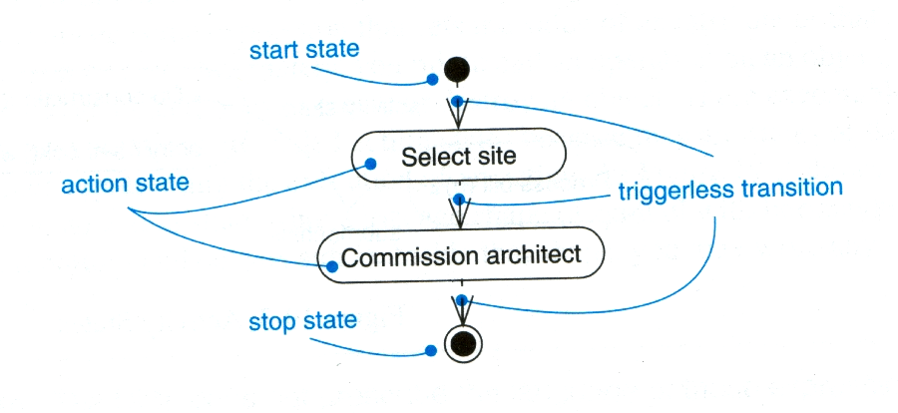
Transitions (2)

Slide 10
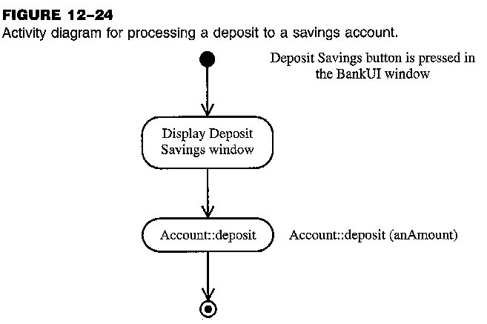
Activity Diagram: Example (1)

Slide 11
Branching (1)
A branch specifies alternate paths taken based on some Boolean expression
A branch may have one incoming transition and two or more outgoing ones

Slide 12
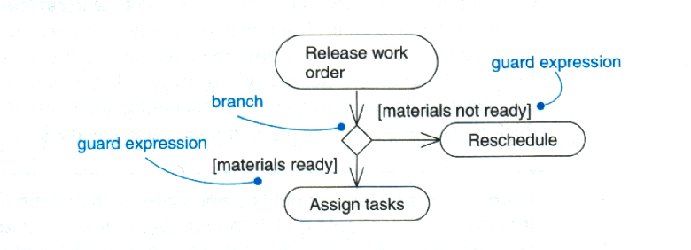
Branching (2)

Slide 13
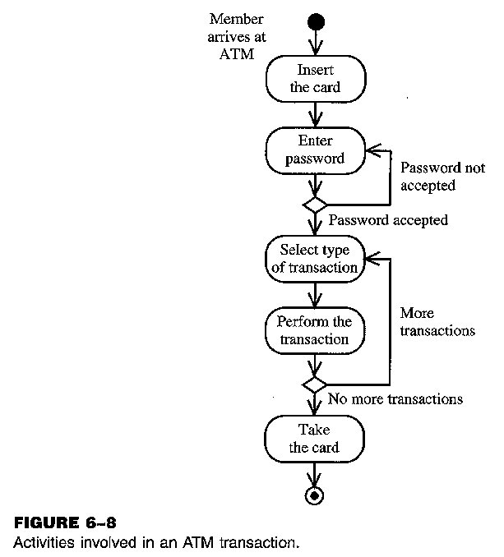
Activity Diagram: Example (2)

Slide 14
Forking and Joining
Use a synchronization bar to specify the forking and joining of parallel flows of control
A synchronization bar is rendered as a thick horizontal or vertical line

Slide 15
Fork
A fork may have one incoming transitions and two or more outgoing transitions
  each transition represents an independent flow of control
  conceptually, the activities of each of outgoing transitions are concurrent
    either truly concurrent (multiple nodes)
    or sequential yet interleaved (one node)

Slide 16
Join
A join may have two or more incoming transitions and one outgoing transition
  above the join, the activities associated with each of these paths continues in parallel
  at the join, the concurrent flows synchronize
    each waits until all incoming flows have reached the join, at which point one flow of control continues on below the join

Slide 17
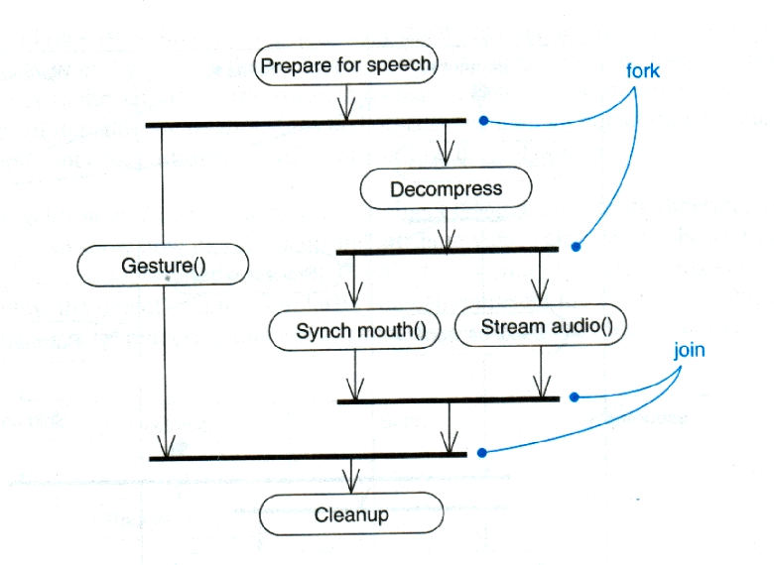
Fork

Slide 18
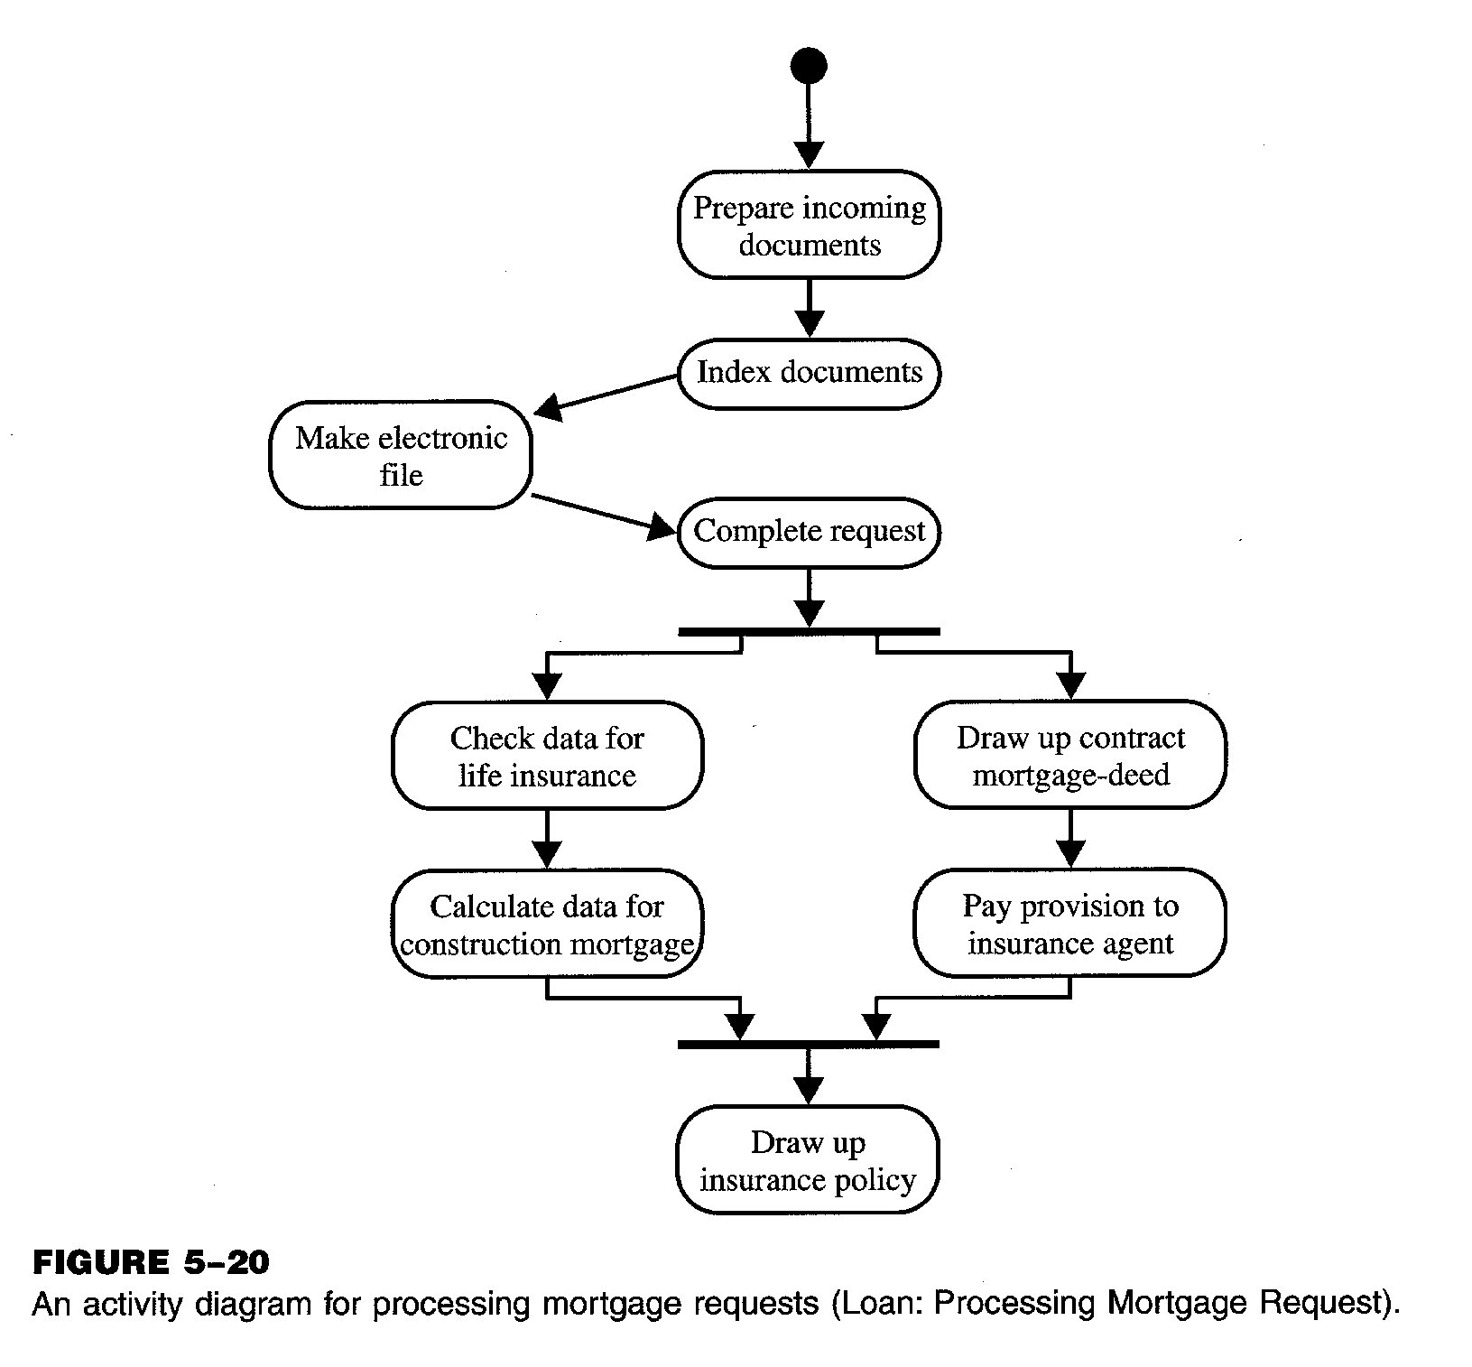
Activity Diagram: Example (3)

Slide 19
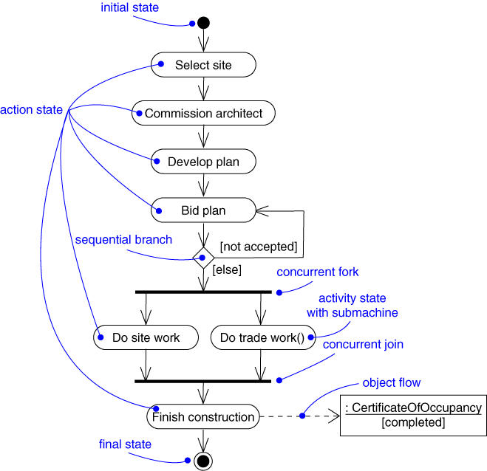
Activity Diagram: Example (4)

Slide 20
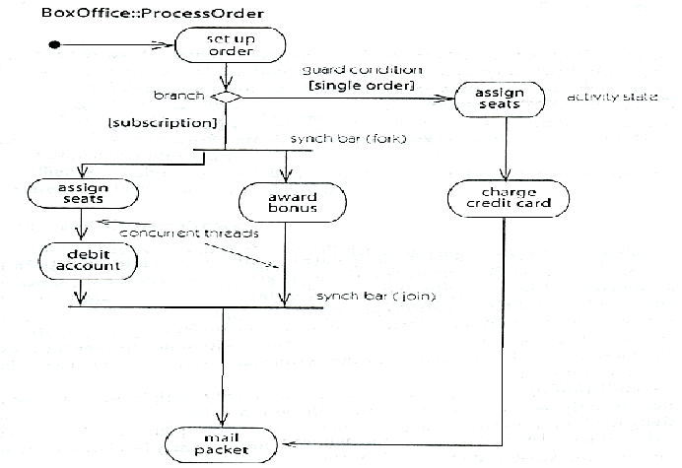
Activity Diagram: Example (6)

Slide 21
Swimlanes (1)
A swimlane specifies a locus of activities
To partition the activity states on an activity diagram into groups
  each group representing the business organization responsible for those activities
  each group is called a swimlane
Each swimlane is divided from its neighbor by a vertical solid line

Slide 22
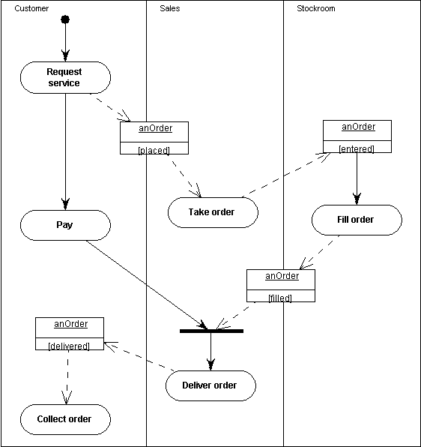
Activity Diagram: Example (8)

Slide 23
Swimlanes (2)
Each swimlane has a name unique within its diagram
Each swimlane may represent some real-world entity
Each swimlane may be implemented by one or more classes
Every activity belongs to exactly one swimlane, but transitions may cross lanes

Slide 24
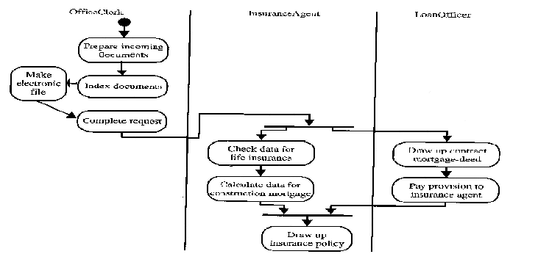
Activity Diagram: Example (9)

